Slide 1

Logical Programming and Data Collections / COMPREHENSIVE EXAMINATION (Part 1)
Module 03

Slide 2

Outline
Selection with Python If
Iteration with While
Collection with List
Python Tuple
Comprehensive Examination (Part 01)

Slide 3
Python - if, elif, else Conditions
By default, statements in the script are executed sequentially from the first to the last.
Python uses the if keyword to implement decision control.
Any Boolean expression evaluating to True or False appears after the if keyword.
Use the : symbol and press Enter after the expression to start a block with an increased indent.
One or more statements written with the same level of indent will be executed if the Boolean expression evaluates to True.

Slide 4
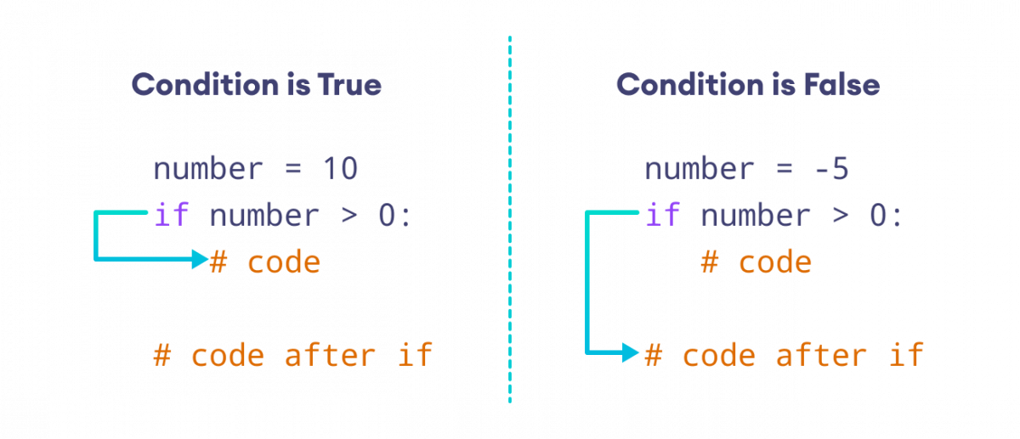
Python - if, elif, else Conditions
To end the block, decrease the indentation.
Subsequent statements after the block will be executed out of the if condition.
If Syntax:
if [boolean expression]:
statement1
statement2
…..
statementN

Slide 5
Python - if, elif, else Conditions
Along with the if statement, the else condition can be optionally used to define an alternate block of statements to be executed if the boolean expression in the if condition evaluates to False.
The indented block starts after the : symbol, after the boolean expression.
It will get executed when the condition is True.
There is another block that should be executed when the if condition is False.
Complete the if block by a backspace and write else, put add the : symbol in front of the new block to begin it, and add the required statements in the block.

Slide 6
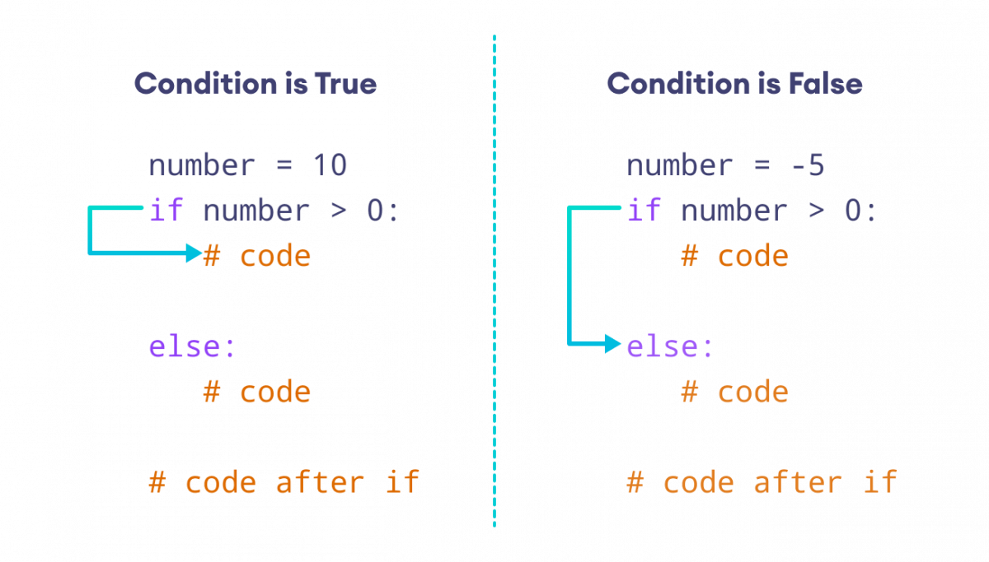
Python - if, elif, else Conditions
else Syntax:
if [boolean expression]:
statement1
…..
statementN
else:
statement1
…..
statementN

Slide 7
Python - if, elif, else Conditions
The elif condition is used to include multiple conditional expressions after the if condition or between the if and else conditions.
The elif block is executed if the specified condition evaluates to True.

Slide 8
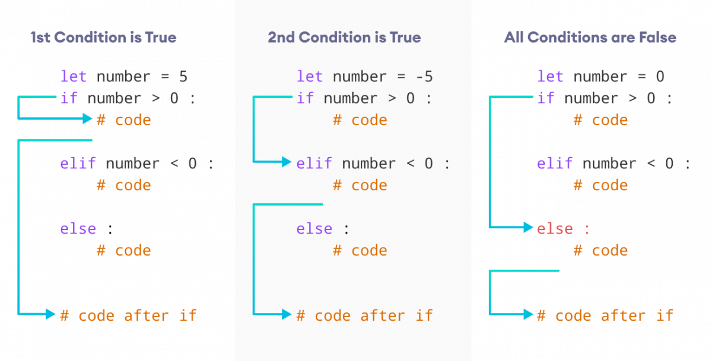
Python - if, elif, else Conditions
elif Syntax:
if [boolean expression]:
[statements]
elif [boolean expression]:
[statements]
elif [boolean expression]:
[statements]
else:
[statements]

Slide 9
Nested if, elif, else Conditions
Python supports nested if, elif, and else condition.
The inner condition must be with increased indentation than the outer condition, and all the statements under the one block should be with the same indentation.

Slide 10
Random Module
The random module in Python provides tools for generating random data. It includes functions for creating random numbers, choosing random items from a sequence, and shuffling sequences. Here are some of the commonly used functions in the random module:
random(): Returns a random floating-point number in the range [0.0, 1.0).
randint(a, b): Returns a random integer N such that a <= N <= b.
choice(seq): Returns a randomly chosen element from a non-empty sequence.
shuffle(seq): Shuffles the elements of a sequence in place.
sample(seq, k): Returns a new list with k unique elements sampled from the sequence.

Slide 11
Ternary Operator
The ternary operator is a concise way to write conditional expressions in Python. It's a one-liner expression that evaluates an expression based on a condition.
Syntax: x = true_value if condition else false_value
condition: The expression that results in either True or False.
true_value: The value assigned to x if the condition is True.
false_value: The value assigned to x if the condition is False.
Nested Ternary Syntax:
x = true_value if condition1 else (true_value_2 if condition2 else false_value)

Slide 12

Simulation [09]
Filename Format: Simulation Day Number + Underscore + Name Initial
Sample: SimulationDay03-09_JTB.py

Slide 13

Let’s work on the problem set!!!
Filename Format: Problem Set Number + Underscore + Name Initial
Sample: PS09_JTB.py

Slide 14
Python - While Loop
Python uses the while and for keywords to constitute a conditional loop, by which repeated execution of a block of statements is done until the specified boolean expression is true.
The python keyword while has a conditional expression followed by the : symbol to start a block with an increased indent.
This block has statements to be executed repeatedly.
Such a block is usually referred to as the body of the loop.
The body will keep executing till the condition evaluates to True.
If and when it turns out to be False, the program will exit the loop.

Slide 15
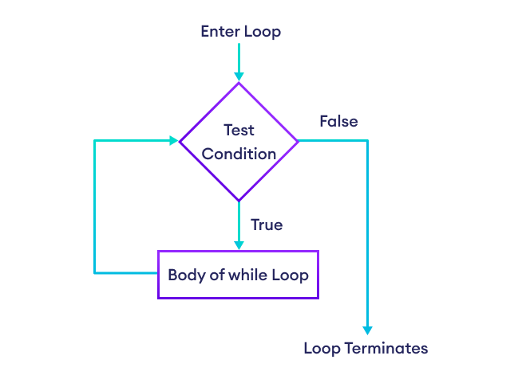
Python - While Loop
while Syntax:
while [boolean expression]:
statement1
statement2
…..
statementN

Slide 16
Exit from the While Loop
Use the break keyword to exit the while loop at some condition.
Use the if condition to determine when to exit from the while loop.

Slide 17
Continue Next Iteration and Range Method
Use the continue keyword to start the next iteration and skip the statements after the continue statement on some conditions.
The range() function is used to generate a sequence of numbers. It produces a range object representing an immutable sequence of numbers. The range() function has multiple ways to be used, but the primary usage is:
range(stop): Generates a sequence from 0 up to stop - 1.
range(start, stop): Generates a sequence from start up to stop - 1.
range(start, stop, step): Generates a sequence from start up to stop - 1, with an increment defined by the step.

Slide 18
While Loop with else Block
The else block can follow the while loop.
The else block will be executed when the boolean expression of the while loop evaluates to False.

Slide 19
Simulation [10]
Filename Format: Simulation Day Number + Underscore + Name Initial
Sample: SimulationDay03-10_JTB.py

Slide 20
Let’s work on the problem set!!!
Filename Format: Problem Set Number + Underscore + Name Initial
Sample: PS10_JTB.py

Slide 21
Python - List
In Python, the list is a mutable sequence type.
A list object contains one or more items of different data types in the square brackets [] separated by a comma.
A list can contain unlimited data depending upon the limitation of your computer's memory.
List items can be accessed using a zero-based index in the square brackets [].

Slide 22
Python - List
Indexes start from zero and increment by one for each item.
Accessing an item using a large index than the list's total items would result in IndexError.
A list can contain multiple inner lists as items that can be accessed using indexes.

Slide 23
Python - List
All the list objects are the objects of the list class in Python.
Use the list() constructor to convert from other sequence types such as tuple, set, dictionary, string to list.
A list items can be iterate using the for loop.
The list is mutable.
You can add new items in the list using the append() or insert() methods, and update items using indexes.

Slide 24
Python - List
Use the remove(), pop() methods, or del keyword to delete the list item or the whole list.
Like the string, the list is also a sequence.
Hence, the operators used with strings are also available for use with the list (and tuple also).

Slide 25
List Operators
Operator | Example in Python Shell
The + operator returns a list containing all the elements of the first and the second list. | >>> L1=[1,2,3] >>> L2=[4,5,6] >>> L1+L2 [1, 2, 3, 4, 5, 6]
The * operator concatenates multiple copies of the same list. | >>> L1=[1,2,3] >>> L1*3 [1, 2, 3, 1, 2, 3, 1, 2, 3]
The slice operator [] returns the item at the given index. A negative index counts the position from the right side. | >>> L1=[1, 2, 3] >>> L1[0] 1 >>> L1[-3] 1 >>> L1[1] 2

Slide 26
List Operators
Operator | Example in Python Shell
The range slice operator [FromIndex : Until Index - 1] fetches items in the range specified by the two index operands separated by : symbol. If the first operand is omitted, the range starts from the index 0. If the second operand is omitted, the range goes up to the end of the list. | >>> L1=[1, 2, 3, 4, 5, 6] >>> L1[1:] [2, 3, 4, 5, 6] >>> L1[:3] [1, 2, 3] >>> L1[1:4] [2, 3, 4] >>> L1[3:] [4, 5, 6] >>> L1[:3] [1, 2, 3] >>> L1[-5:-3] [2, 3]

Slide 27
List Operators
Operator | Example in Python Shell
The in operator returns true if an item exists in the given list. | >>> L1=[1, 2, 3, 4, 5, 6] >>> 4 in L1 True >>> 10 in L1 False
The not in operator returns true if an item does not exist in the given list. | >>> L1=[1, 2, 3, 4, 5, 6] >>> 5 not in L1 False >>> 10 not in L1 True

Slide 28
List Methods
List Method | Description
list.append() | Adds a new item at the end of the list.
list.clear() | Removes all the items from the list and make it empty.
list.copy() | Returns a shallow copy of a list.
list.count() | Returns the number of times an element occurs in the list.
list.extend() | Adds all the items of the specified iterable (list, tuple, set, dictionary, string) to the end of the list.
list.index() | Returns the index position of the first occurance of the specified item. Raises a ValueError if there is no item found.
list.insert() | Inserts an item at a given position.

Slide 29
List Methods
List Method | Description
list.pop() | Returns an item from the specified index position and also removes it from the list. If no index is specified, the list.pop() method removes and returns the last item in the list.
list.remove() | Removes the first occurance of the specified item from the list. It the specified item not found then throws a ValueError.
list.reverse() | Reverses the index positions of the elements in the list. The first element will be at the last index, the second element will be at second last index and so on.
list.sort() | Sorts the list items in ascending, descending, or in custom order.

Slide 30
Simulation [11]
Filename Format: Simulation Day Number + Underscore + Name Initial
Sample: SimulationDay03-11_JTB.py

Slide 31
Let’s work on the problem set!!!
Filename Format: Problem Set Number + Underscore + Name Initial
Sample: PS11_JTB.py

Slide 32

Trainer’s Tips 05:
INSTILL VALUES
As a trainer, you should imbue participants with a set of values, ethics, or guiding principles. For instance, values such as discipline, consistency, reliability, innovation, respect, integrity, or quality may be emphasized to foster a particular work culture or set of behaviors within the training environment. The goal is to have these values integrated into the participants' mindset and actions, influencing their decisions and behaviors beyond the training sessions.

Slide 33
Tuple
Tuple is an immutable (unchangeable) collection of elements of different data types.
It is an ordered collection, so it preserves the order of elements in which they were defined.
Tuples are defined by enclosing elements in parentheses (), separated by a comma.

Slide 34
Tuple
It is not necessary to enclose the tuple elements in parentheses.
The tuple object can include elements separated by a comma without parentheses.
Tuples cannot be declared with a single element unless followed by a comma.

Slide 35
Tuple
Each element in the tuple is accessed by the index in the square brackets [].
An index starts with zero and ends with (number of elements - 1).
The tuple supports negative indexing also, the same as list type.
The negative index for the first element starts from -number of elements and ends with -1 for the last element.
Tuple elements can be unpacked and assigned to variables.

Slide 36
Tuple
The number of variables must match with the number of elements in a tuple; otherwise, an error will be thrown.
Tuple is unchangeable. So, once a tuple is created, any operation that seeks to change its contents is not allowed.
The underlying type of a tuple is the tuple class.
Check the type of a variable using the type() function.
The tuple() constructor is used to convert any iterable to tuple type.

Slide 37
Tuple Operation
Like string, tuple objects are also a sequence. Hence, the operators used with strings are also available for the tuple.
Operator | Example
The + operator returns a tuple containing all the elements of the first and the second tuple object. | t1=(1,2,3) t2=(4,5,6) print(t1+t2) #(1, 2, 3, 4, 5, 6) t2+(7,) #(4, 5, 6, 7)
The * operator Concatenates multiple copies of the same tuple. | t1=(1,2,3) t1*4 #(1, 2, 3, 1, 2, 3, 1, 2, 3, 1, 2, 3)
The [] operator Returns the item at the given index. A negative index counts the position from the right side. | t1=(1,2,3,4,5,6) t1[3] # 4 t1[-2] #5
The in operator returns true if an item exists in the given tuple. | t1=(1,2,3,4,5,6) 5 in t1 #True 10 in t1 #False

Slide 38
Tuple Operation
Operator | Example
The not in operator returns true if an item does not exist in the given tuple. | t1=(1,2,3,4,5,6) 4 not in t1 #False 10 not in t1 #True
The [:] operator returns the items in the range specified by two index operands separated by the : symbol. If the first operand is omitted, the range starts from zero. If the second operand is omitted, the range goes up to the end of the tuple. | t1=(1,2,3,4,5,6) t1[1:3] #(2, 3) t1[3:] #(4, 5, 6) t1[:3] #(1, 2, 3)

Slide 39
Simulation [12]
Filename Format: Simulation Day Number + Underscore + Name Initial
Sample: SimulationDay03-12_JTB.py

Slide 40
Let’s work on the problem set!!!
Filename Format: Problem Set Number + Underscore + Name Initial
Sample: PS12_JTB.py

Slide 41

Trainer’s Tips 06:
TIMED DELIVERY
As a trainer, you should structure the content or course curriculum in a way that ensures topics, exercises, or modules are presented within a predetermined time-frame. This approach is about carefully planning and scheduling the distribution of the learning materials, exercises, and practical sessions throughout the training duration.

Slide 42
Sources:
https://www.python.org/downloads/
https://youtu.be/i-MuSAwgwCU
https://classroom.google.com/c/NTE5NzI3NDA3NTU1/m/NjA4MjI3MDEwMTc5/details
https://youtu.be/VC13MkENVoY
https://youtu.be/GenKovl05YU
https://youtu.be/riL_xn6BKD8
https://youtu.be/_uQrJ0TkZlc
https://docs.python.org/3/tutorial/index.html
https://www.pythontutorial.net/
https://www.programiz.com/python-programming
https://www.tutorialsteacher.com/python
https://www.tutorialspoint.com/python/index.htm
https://www.w3schools.com/python/
https://www.onlinegdb.com/
https://intellipaat.com/blog/tutorial/python-tutorial/?US

Slide 43
Thank you…

